Slide 1
Presentation On Home Service Booking
Presented By
Tahmid Hasan
Department Of CSE
Pabna University Of Science & Technology
2016-2017

Slide 2
Idea Behind project
Makes people's life easy by Providing handy service
1
User can book any kind of home service by seconds
2
User can visit,read blogs,service details etc...
3
Admin can handle every activities behind the scene
4

Slide 3
Objectives
Provides A Compact and Ready-Made System For the User to book services without any hassle
User can compare and book any services according to their incomes what suits them better
Removes Negotiation Hassle for the user
Provides A full Management System for the Admin to face and solve each problems

Slide 4
Tools & Technologies USED
HTML5
CSS
JAVASCRIPT
Bootstrap
PHP
MYSQL
Laravel framework
Vs code editor
Command Line Terminal

Slide 5
Admin Feature
Login
Register
Category, subcategory, service entry
Manage complains, reviews
Handle setting, coupons, shipping areas
Handle reports
Manage users, admins
Etc.....

Slide 6
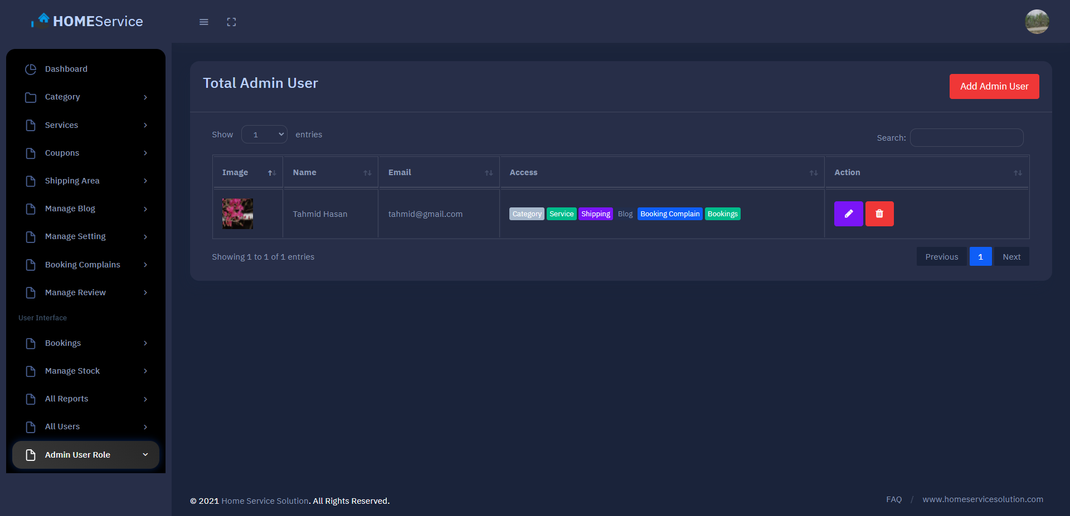
GUI EXAMPLE

Slide 7
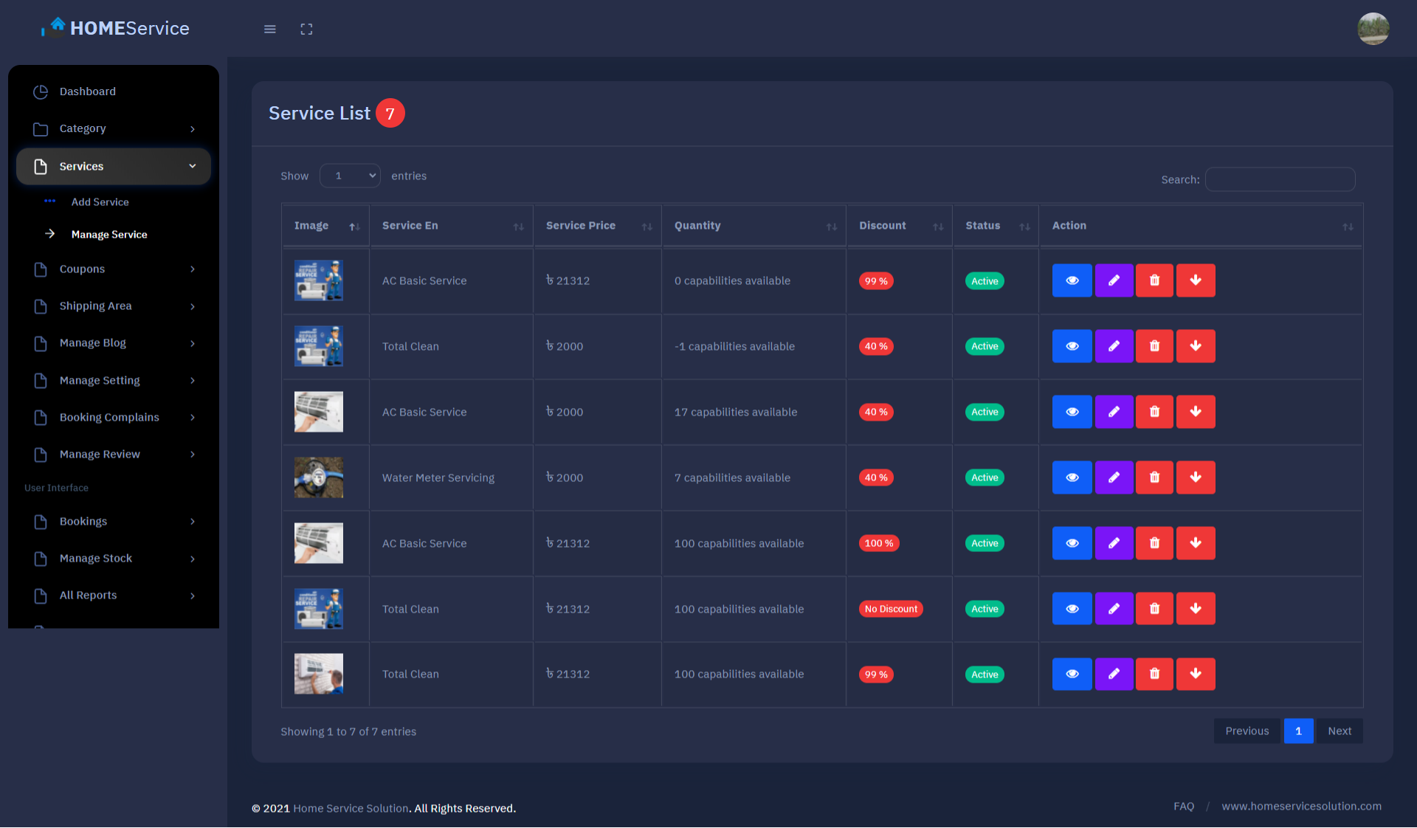
GUI EXAMPLE

Slide 8
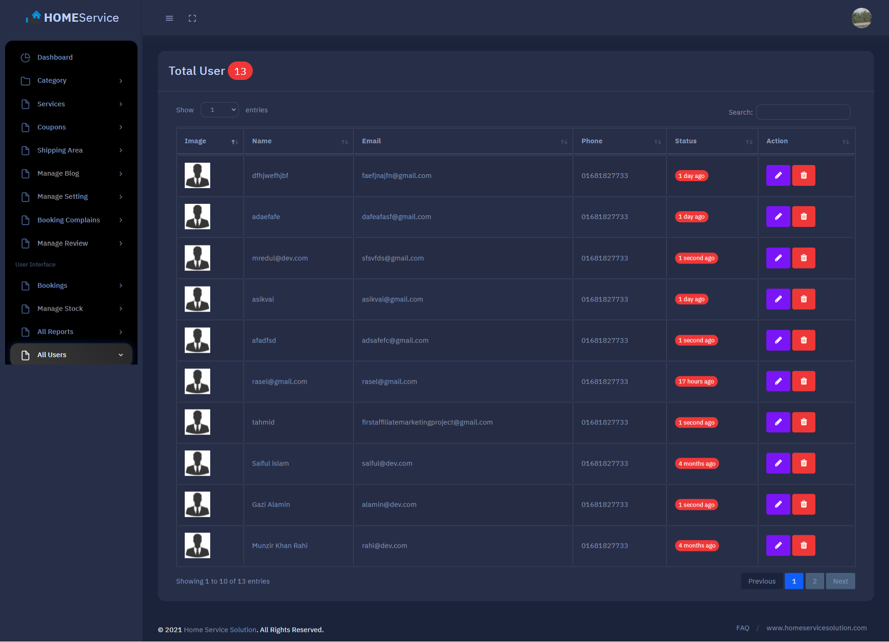
GUI EXAMPLE

Slide 9
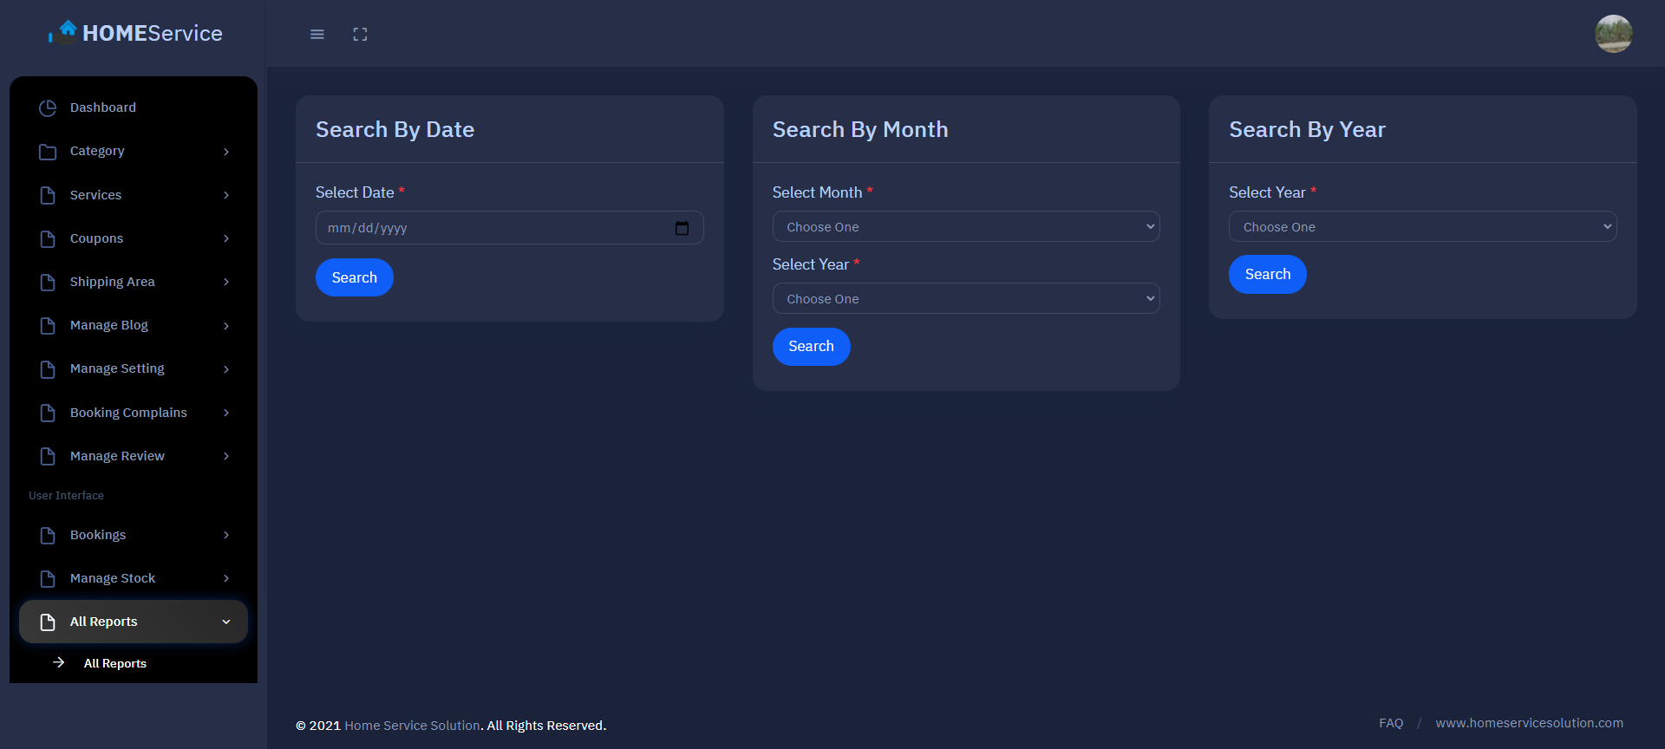
GUI EXAMPLE

Slide 10
USER Feature
Login
Register
Visit, search service, read blogs
Book service
Pay for service
Review service
Complain about service
Etc.....

Slide 11
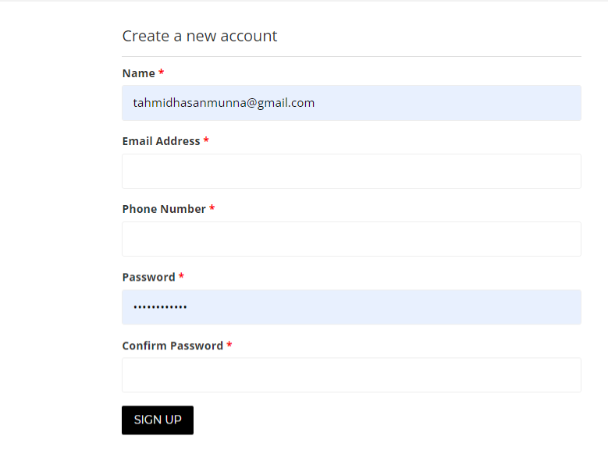
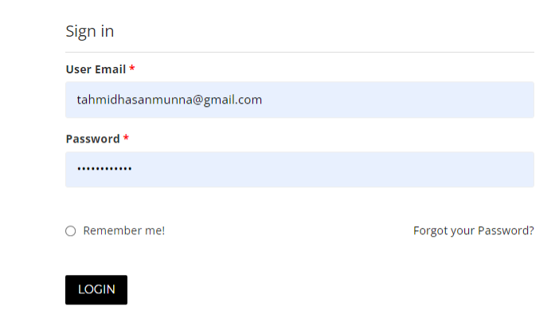
GUI EXAMPLE

Slide 12
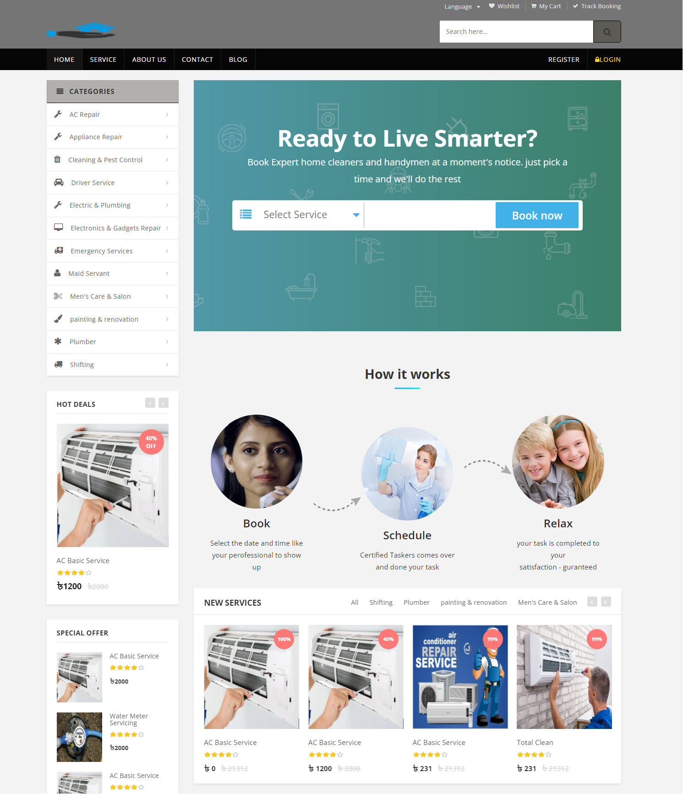
GUI EXAMPLE

Slide 13
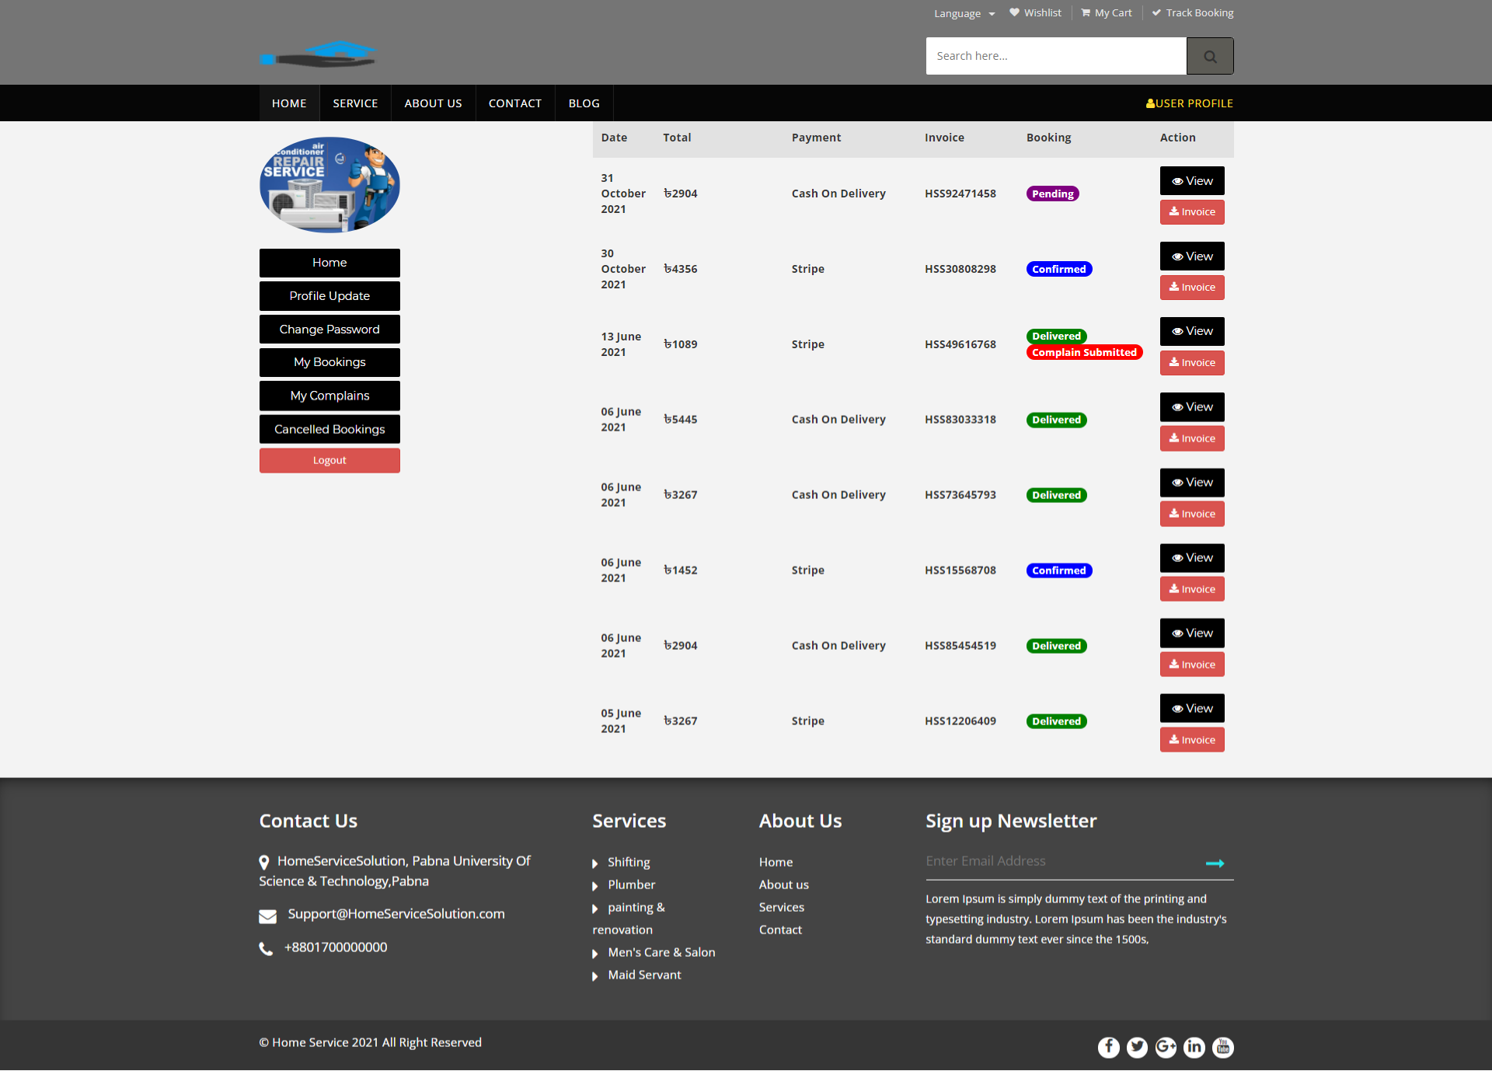
GUI EXAMPLE

Slide 14
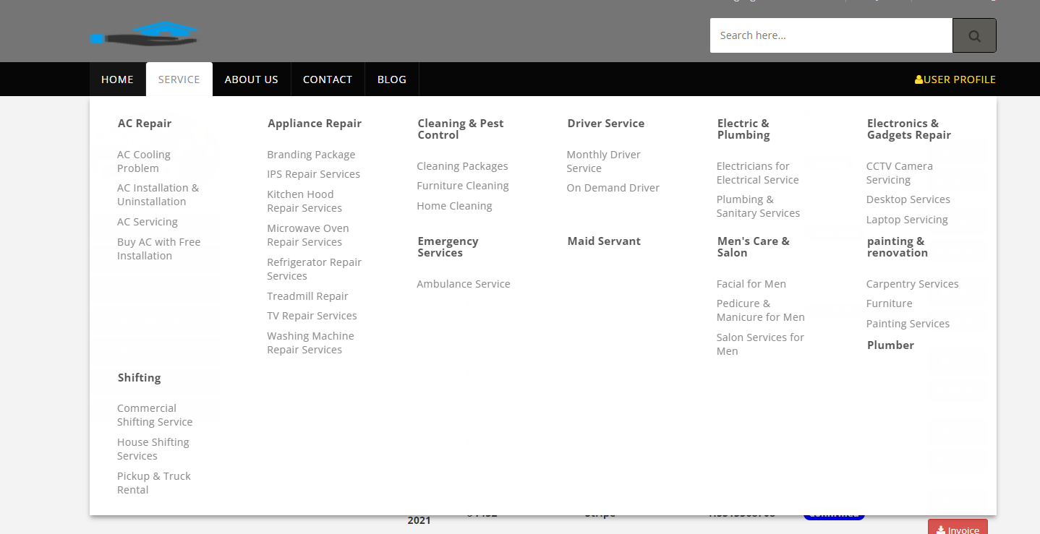
GUI EXAMPLE

Slide 15

Thanks for your valuable time

